Slide 1
Age Structured
Production Models using Integrated Analysis

Slide 2
Outline
Goal: create age-structured, integrated models for data-poor problems for which biomass dynamic models are typically applied
Example : Schaefer model
Conclusions

Slide 3
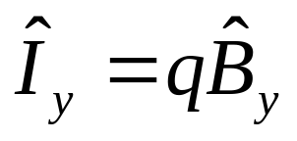
Example: Schaefer model
Data are 24 years of catch (C) and CPUE (I) from 1965-1988 from Namibian hake (Polacheck, 1993)
Schaefer model implemented in Excel and ADMB
  B_{y+1} = B_{y} + r B_{y} (1 - B_{y} /K ) - C_{y}
Estimated parameters are
  r (maximum population growth rate)
  K (equilibrium biomass)
  q (catchability)

Slide 4
Stock Synthesis Model
Fully age structured (plus group = age 10,
with arbitrary inputs for growth, maturity,
and fecundity)
All ages fully selected
All ages mature
No recdevs
Estimated parameters are
  R₀ (equilibrium recruitment)
  either M (natural mortality) or h (steepness)
  catchability as derived quantity

Slide 5
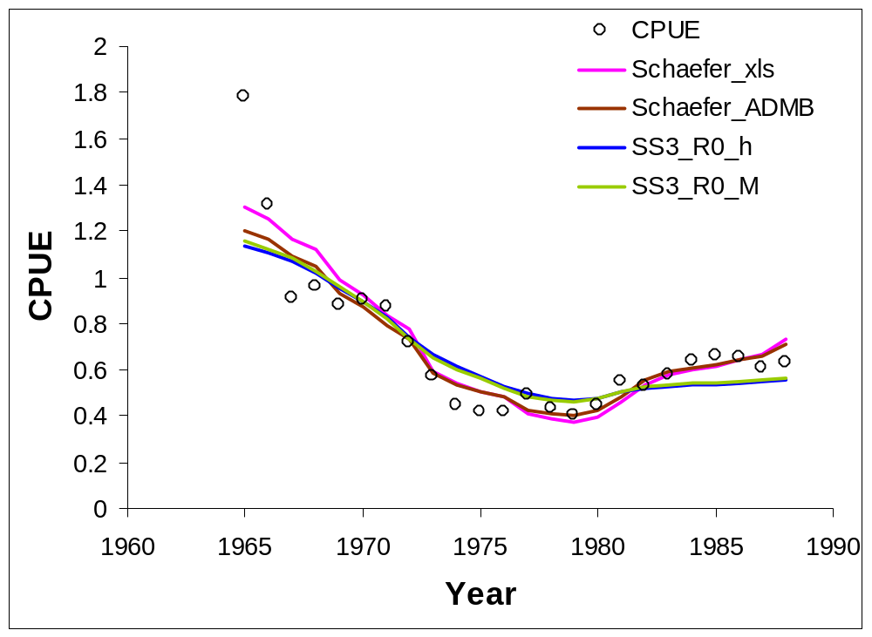
Comparing model results

Slide 6
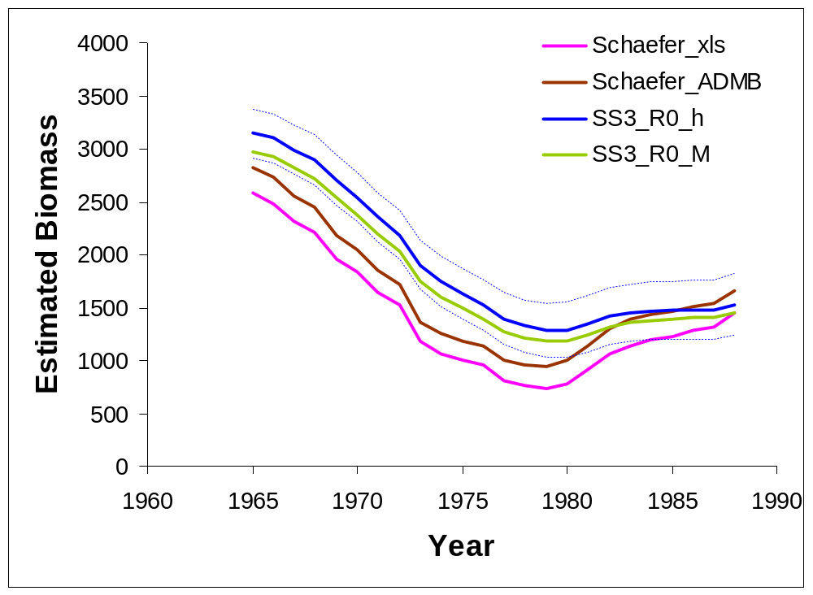
Comparing model results

Slide 7
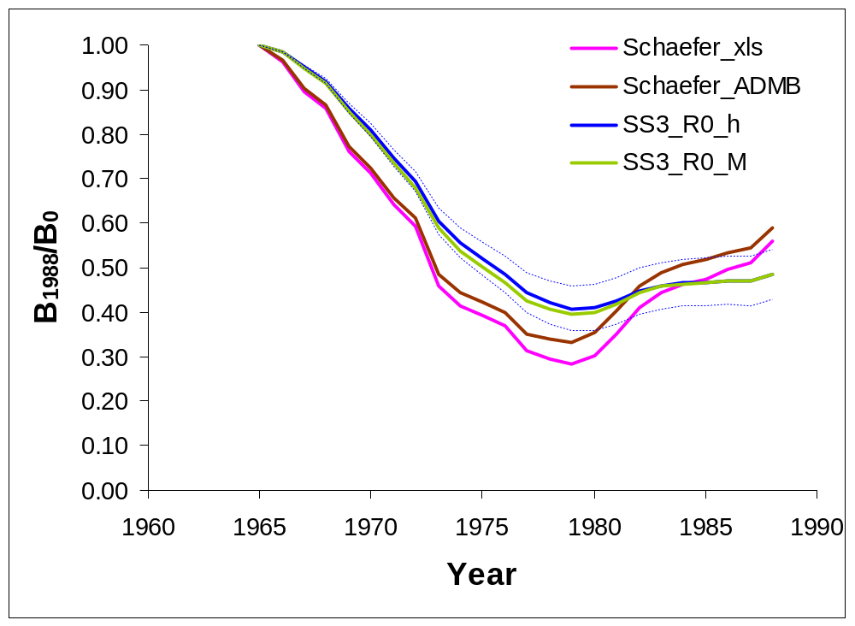
Comparing model results

Slide 8
Comparing model results
 | MSY | B₀ | B₁₉₈₈ | B₁₉₈₈/B₀
Schaefer_xls | 267 | 2575 | 1442 | 0.56
Schaefer_ADMB | 261 | 2820 | 1660 | 0.59
SS3_R0_h | 233 | 3145 | 1523 | 0.48
SS3_R0_M | 230 | 2976 | 1441 | 0.48

Slide 9
Conclusions from Schaefer example
Age structured production model requires no more estimated parameters than Schaefer model
Fit to CPUE data is similar
Model output is similar
SS allows additional flexibility in many directions

Slide 10
General conclusions on age structured production models
More options than simpler biomass dynamic models
  provides greater ability to explore alternative scenarios and uncertainty
  but requires more thinking about choices made
Parameters have more direct biological interpretations
Allows increase in complexity (and realism) through incorporation of additional data types
  data on growth and maturity (or external estimates)
  a single length or age composition would allow estimation of selectivity
  priors based on biological parameters from similar species

